Slide 1

Python Data Types
Life Choices Coding Academy 2020

Slide 2
Learning Outcome:
By the end of this lesson, students should know:
Python basic data types.
How to manipulate different python data types. using python built-in functions.

Slide 3
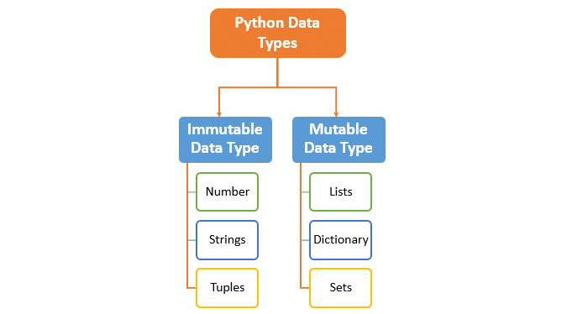
INTRODUCTION
What is python data type?
Why do we need a data type?
Notes:
What is a data type? Programming languages uses a number of different data types. A data type determines what type of value and item can have and what operations can be performed on the item.
Data types are especially important in all programming languages because the specific data type you use will determine what operations you can perform on it.

Slide 4
Python Data Types
Strings - consist of zero or more characters. You can think of a string as plain text. eg(“1234”, “Hello World :)”)
Integers - are whole numbers and can be either positive or negative.
Boolean - can only represent two values, either true or false.
List - ordered collection of one or more data items.
Tuple - ordered collection of one or more data items.
Dictionary - unordered collection of items. Has a key: value pair.
Set - an unordered collection of items.
You use dir() function to check what extra methods can be performed on a data type.
Notes:
Mention that sometimes a distinction is made between short and long integers, referring to how much data storage is used for the number.
Typically, a 1 is used to represent True, and a 0 is used to represent False.
Consider the following example where a user inputs two values and the program determines whether the first one is smaller than the second one or not.
X = 8, y = 7, x < y, the value returned will be of boolean data type.
Mention the differences between List and Tuple on how they are different(square brackets vs parentheses)
Do a demonstration of using the dir(function). Use help() to demonstrate usage of dir()

Slide 5
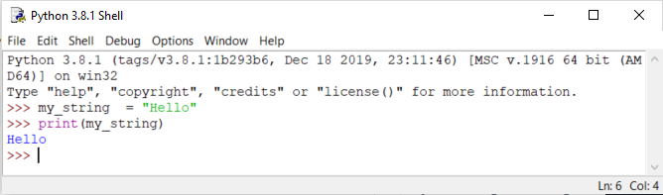
Working with Python Strings
How to create a string in Python?
You use a built-in function type() to check the data type of a string.
Check the handout for more information regarding string data type.
Notes:
Remember a string is a sequence of characters. A character is simply a symbol. For example, the english language has 26 characters.
Strings can be created by enclosing characters inside quotes. Quotes can be single. Even triple quotes can be used in Python but generally used to represent multiline string and docstring
Demonstrate the use of single, double and triple quotes.

Slide 6
Python String Data Type Quiz- 1(Slicing)
Q1. What will be the output of each python code?
message = “We are getting a Pizza.”
print(message)
print(message[0])
print(type(message))
print(message[0:5])
Q2. Write a single statement to reverse a string using string slicing.
Expected input: lifechoices
Expected output: seciohcefil
Notes:
Demonstrate answers here and get an interview where this kind of a question was asked.(Apple)
Apple Inc asked one of the potential candidate Q2 at an interview: https://www.google.com/search?q=reverse+list+python+glassdoor&oq=reverse+list+python+glassdoor&aqs=chrome..69i57.18705j0j4&sourceid=chrome&ie=UTF-8

Slide 7
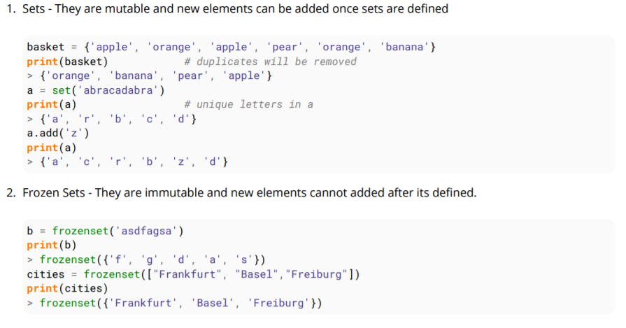
Set Data Types
Sets are unordered collections of unique objects, there are two types of sets in Python.
Notes:
You specify the data type by using a constructor function as follows x = str(“Hello World!”) => str
x = set((“apple”, “banana”, “cherry”))
etc.

Slide 8
Numbers Data Type
Integers, floating point numbers and complex numbers fall under Python Numbers
We can use the type() function to check which class does a specific value belong to.
Notes:
Integers can be of any length, it is only limited by the memory available.
Complex numbers are written in the form, x + yj, where x is the real part and y is the imaginary part.

Slide 9
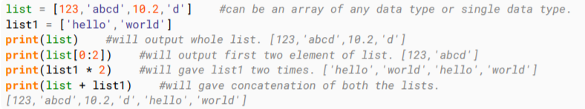
List Data Type
A list contains items separated by commas and enclosed within square brackets []. Lists are almost similar to arrays in C or C++. One difference is that all the items belonging to a list can be of different data type.
Lists have many methods, including index, count, remove, reverse, sort to name a few.
Notes:
Make a demonstration on the command line for list methods. Index, count, remove

Slide 10
Python List Data Type Quiz- 2
Q1. Given a list [1,2,3,4,5] write a program to sum all the items in it?
Expected input: [1,2,3,4,5]
Expected output: 15
Q2. Write a single statement to sort list in increasing order?
Expected input: [4,1,5,3,2]
Expected output: [1,2,3,4,5]
Q2. Now reverse the list in descending order.
Expected input: [4,1,5,3,2]
Expected output: [5,4,3,2,1]
Notes:
Demonstrate answers here and get an interview where this kind of a question was asked.(Apple)
Link to interviews Questions: https://www.google.com/search?q=reverse+list+python+glassdoor&oq=reverse+list+python+glassdoor&aqs=chrome..69i57.18705j0j4&sourceid=chrome&ie=UTF-8
Q1 - Can be rephrased as, given a list of goods purchased(prices), find the total price of the items.
For Q2, you can also use sorted > https://www.programiz.com/python-programming/methods/list/sort

Slide 11
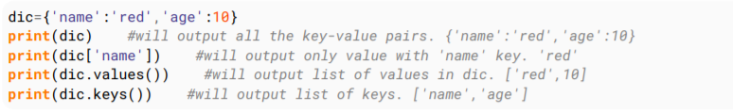
Dictionary Data Type
Dictionary consists of key-value pairs. It is enclosed by curly braces {} and values can be assigned and accessed using square brackets[].
A key can be of any type.
Notes:
If you require storing the salaries of employees in a list, an int-indexed based array can’t be the best choice and may always be confusing.
Explore other methods using dir() and help().
The handout will focus more on dictionaries.

Slide 12

Tuple Data Type
A tuple is a sequence of immutable Python objects. Tuples are sequences, just like lists..
Notes:
The differences between tuples and lists are, the tuples cannot be changed unlike lists and tuples use parentheses, whereas lists use square brackets.
Demonstrate tuple functions in the command line.

Slide 13
Getting input from the user in Python

Slide 14

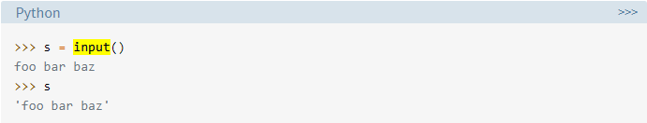
User Input
Use the input() function for Python 3Python 3.x
raw_input is for Python2.X
Notes:
Program often need to obtain data from the user, usually by way of input from the keyboard.
The simplest way to accomplish this in Python is with input()
Definition of input() - pauses program execution to allow the user to type in a line of input from the keyboard. Once the user presses the Enter key, all characters typed are read and returned as a string:
Do class demonstration of the input function.
input() always returns a string. If you want a numeric type, then you need to convert the string to the appropriate type with the int(), float(), or complex() built-in functions:

Slide 15

Python Casting
The process of converting the o5555555555555 one data type to another type
Implicit / Explicit Type Conversion
Done using construct functions.5555555555555555555555555555555555555555555555555555555
Notes:
Program often need to obtain data from the user, usually by way of input from the keyboard.
The simplest way to accomplish this in Python is with input()
Definition of input() - pauses program execution to allow the user to type in a line of input from the keyboard. Once the user presses the Enter key, all characters typed are read and returned as a string:
Do class demonstration of the input function.
input() always returns a string. If you want a numeric type, then you need to convert the string to the appropriate type with the int(), float(), or complex() built-in functions:
Implicit - automatically performed by the Python interpreter.(To avoid data loss, int vs float)
Explicit - convert the data type of an object to required data type.

Slide 16
Thanks:)
Notes:
Anyone still struggling with the previous exercise?

